Slide 1

SailPoint IdentityIQ
SailPoint IIQ is a complete GRC(Governance, Risk and Compliance) based Identity and Access Management Tool built on common Identity Governance framework. It offers wide range of services
Identity Life cycle management
Password management
User provisioning
Birthright Provisioning
Manage Access Request
User Access Reviews
SOD Policies
Analytics and Reporting
User Capabilities
End user portal
Admin portal
IDE for Development

Slide 2

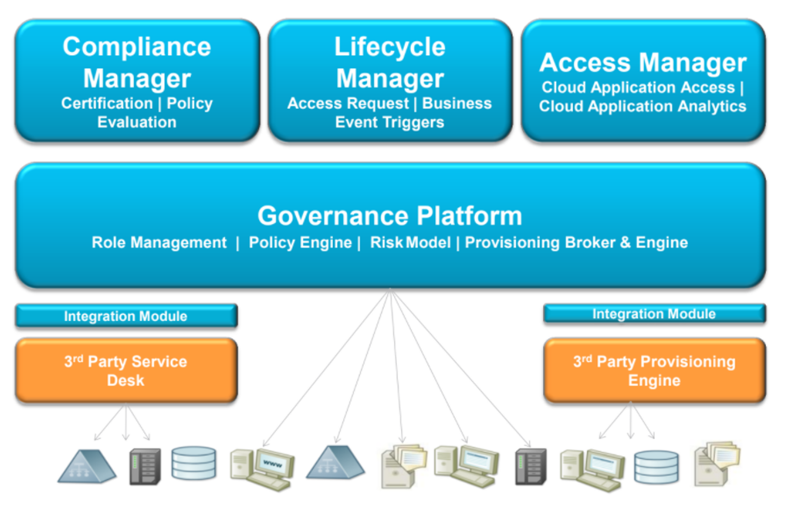
SailPoint IIQ Components

Slide 3

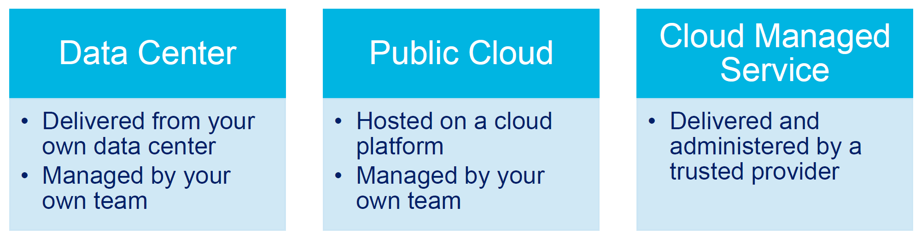
Installation Components
Java Runtime
Application Server
IdentityIQ Software running inside the Application Server
Database Management System
Other Components (dependent upon the implementation goals)
Ex: IQService if provisioning to Active Directory
Deployment Options

Slide 4
Supported Platforms
Operating Systems
SUSE Linux Enterprise Server 15 and 12
Windows Server 2016 and 2019
CentOS 8.3 and 7.9
Application Servers
Apache Tomcat 9.0 and 8.5
Oracle WebLogic 14c and 12cR2
IBM WebSphere 9.0
JBoss EAP 7.3 and 7.2
IBM WebSphere Liberty 20.0 and 19.0
Mobile User Interface OS/Browser Support
Android 11 on Chrome
iOS 14 (beta) and 13 using Safari
Languages
Brazilian Portuguese
Danish
Dutch
English
French
French Canadian
German
Italian
Japanese
Korean
Norwegian
Polish
Portuguese
Simplified Chinese
Spanish
Swedish
Traditional Chinese
Turkish
Databases (On Site)
IBM DB2 11.5
MySQL 5.7 and 8.0
MS SQL Server 2019 and 2017
Oracle 19c
Cloud Platforms
AWS EC2
AWS Aurora
AWS RDS (MySQL, MS SQL, Oracle)
Azure (VM, Azure SQL)
Google Cloud Platform - Google Compute Engine
Java Platform
Sun, Oracle or IBM JDK 1.8 (8), JDK 11 for all application servers
OpenJDK11 is now supported on all structures, but we have specifically tested against Adopt OpenJDK 11 for Windows and Red Hat OpenJDK 11 for Linux.
Browsers
Google Chrome Latest Version
Internet Explorer New Chromium version of Edge
Safari 14
Firefox Latest Version

Slide 5

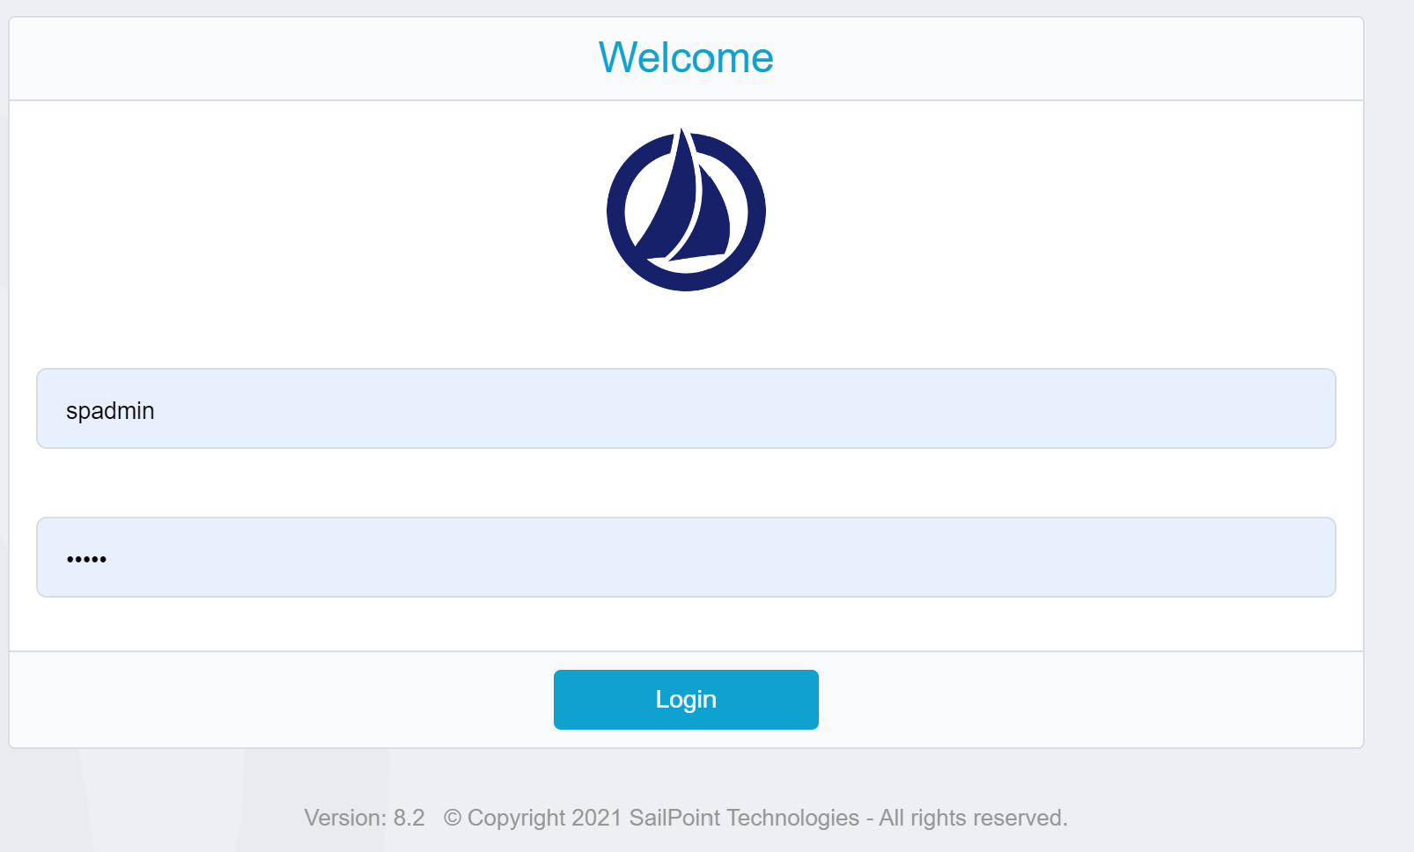
SailPoint IIQ Console – Login page
Access SailPoint Portal using http://localhost:8080/identityiq

Slide 6
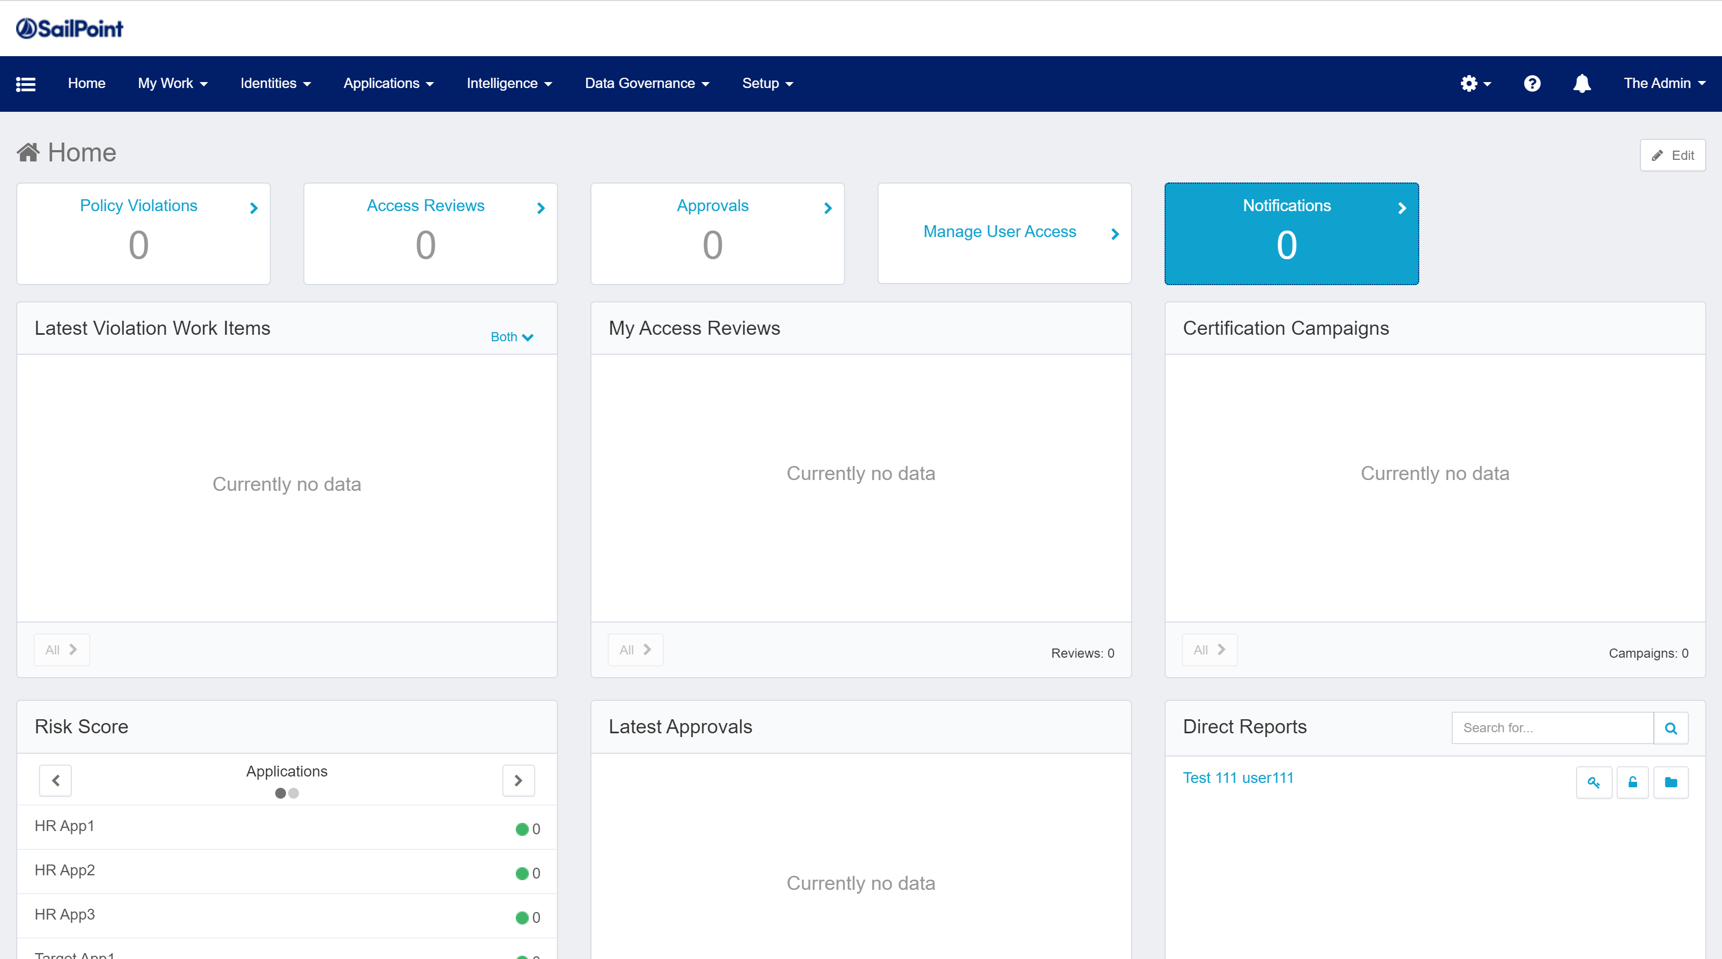
SailPoint IIQ Console – Admin View

Slide 7

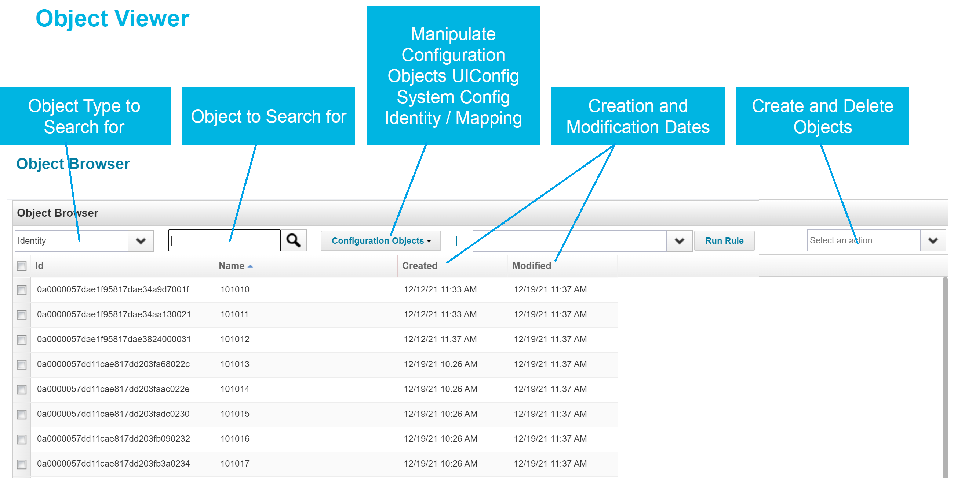
Debug
Access SailPoint debug page using http://localhost:8080/identityiq/debug
It’s the same portal but a different page where only Admins can access
This acts just like public static void main (String[] args) method in Java
Believe me this is a great tool unlike any other IAM tool, you can view any object XML, you can edit it directly and you can test every piece of logic you develop.
You don’t need any tools like Visual Studio or Sharepoint which are licensed

Slide 8

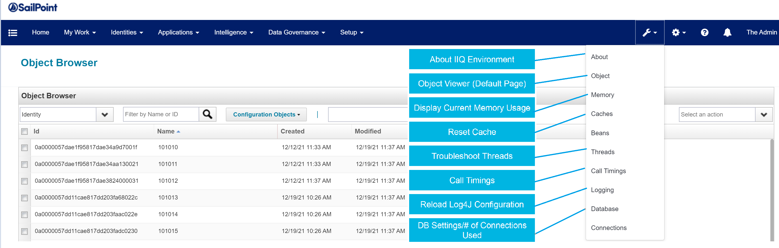
Debug – System Information
You find a lot of information and functionalities in debug page
About page – You find all the information about how many identities you have, software and versions you are using
Caches – It is very helpful to clear the cache when you update scripts without server restart
Logging – You can reload Log4j configuration without server restart
Updating scripts/configs without restart a game changer unlike a lot of other IAM tools which saves a lot of hours of time

Slide 9

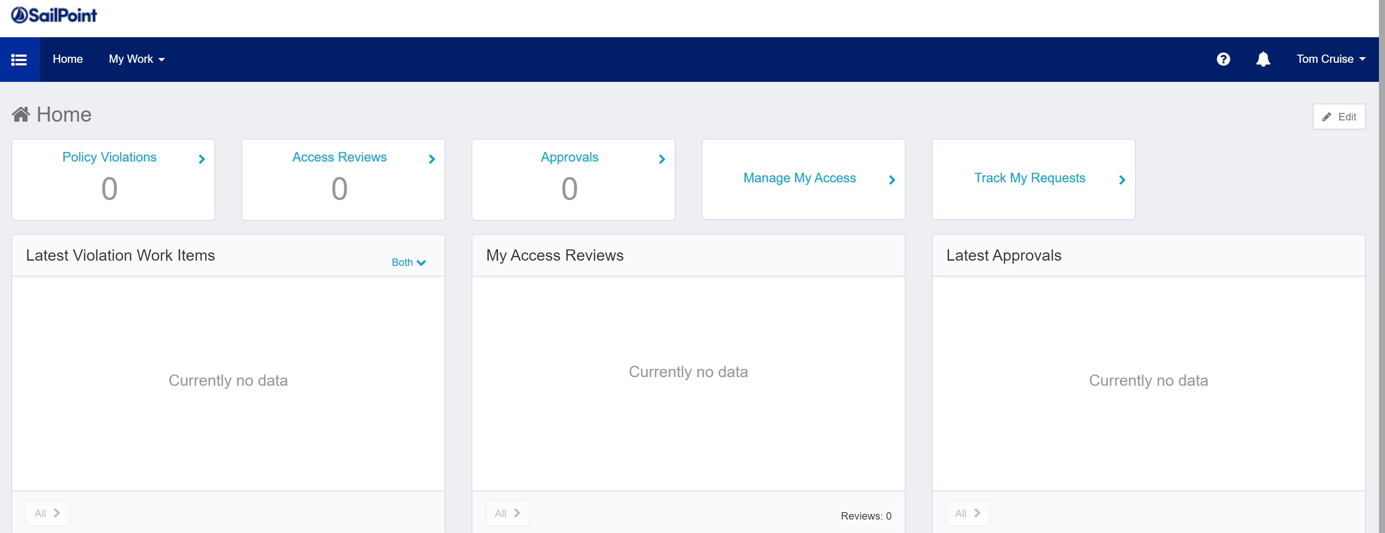
SailPoint IIQ Console – End User View
SailPoint is more user friendly or business centric application where you don’t need Administrator to get access
For example, couple of years back in IBM Tivoli tools, we use to get emails from users for any access as an email or an Incident.
We used to send email to user’s manager and/or application owner asking for approvals to provide access for same user, which is completely manual and time-consuming process.
But in SailPoint, we configure approval levels, approvers for different access for different apps
When a user requests, approval will be triggered to concerning approvers automatically, we will cover this in detail in later concepts.

Slide 10

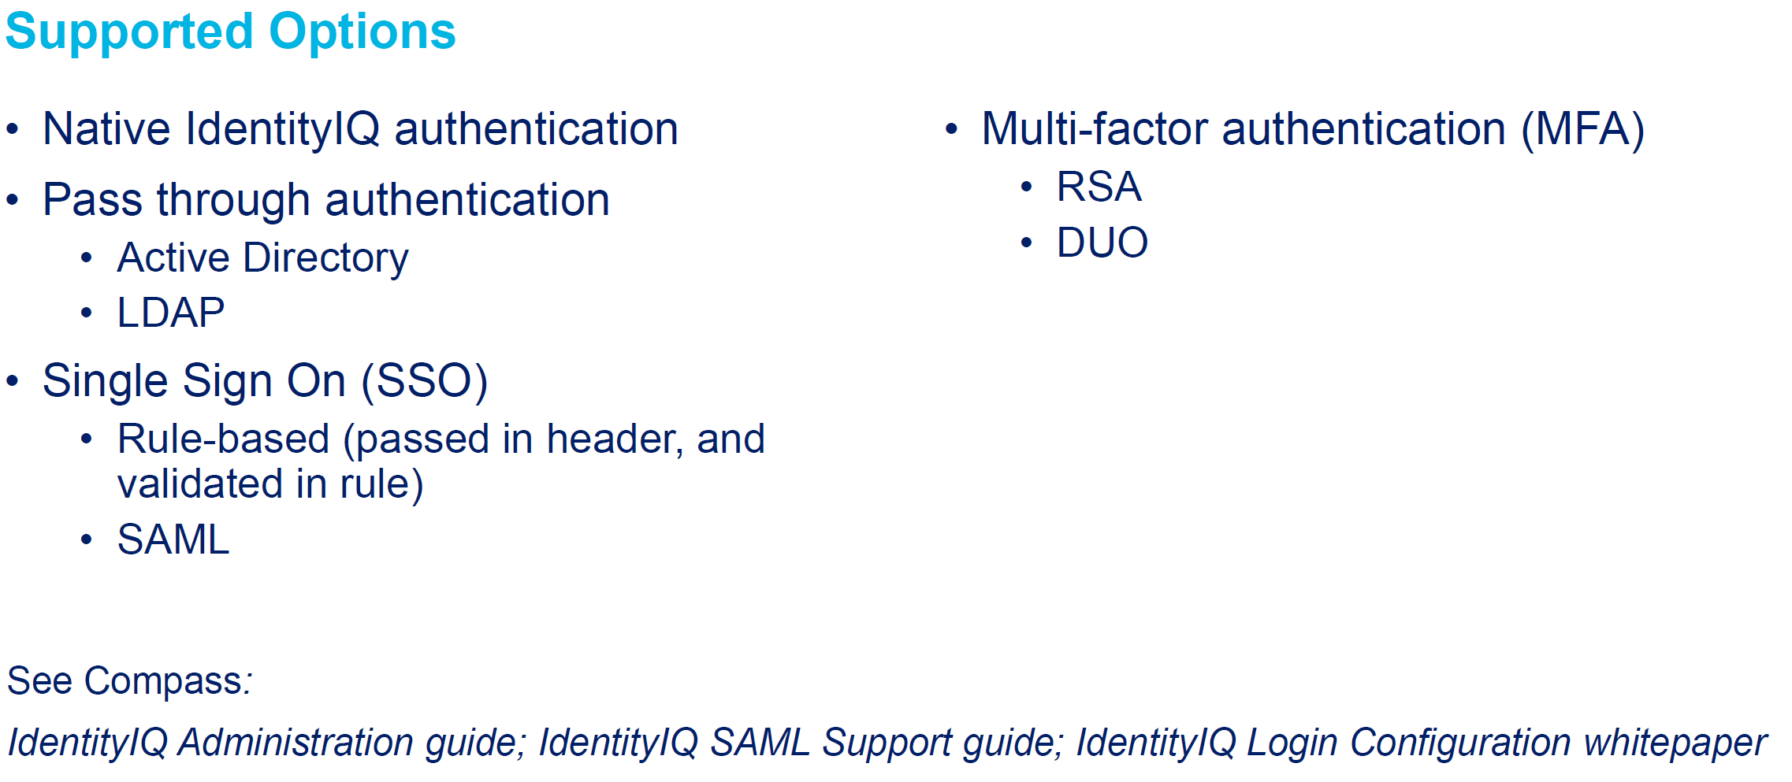
Identity IQ Authentication
As you have seen login page, you can use spadmin/admin default account you get when you are running SQL queries given by SailPoint while installing
Along with Native authentication, you can use passthrough Authentication (using credentials of an application) like Active Directory, highly used
We can implement SSO and MFA using SailPoint recommendations which we will cover later
You can Integrate SailPoint IIQ application in Okta and access using Okta SSO as well

